Slide 1
Deep Learning Bandgaps of Topologically Doped Graphene
PPT slides for Figures
Yuan Dong1ξ, Chuhan Wu2ξ, Chi Zhang1, Jianlin Cheng2*, Jian Lin1*
1Department of Mechanical & Aerospace Engineering 2Department of Electrical Engineering & Computer Science, University of Missouri, Columbia, Missouri 65211, USA *E-mail: LinJian@missouri.edu (J. L.) or chengji@missouri.edu (J. C.) ξ Contributed equally to this work.

Slide 2
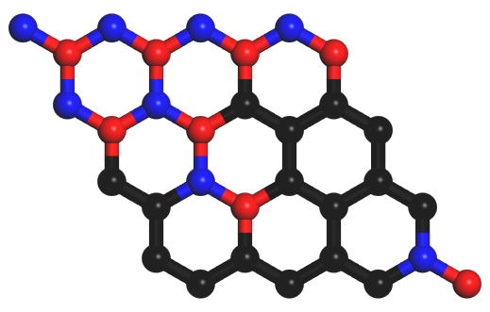
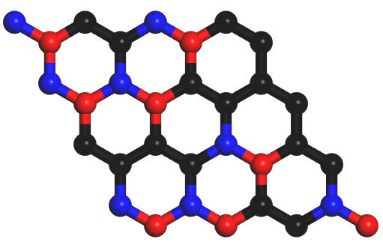
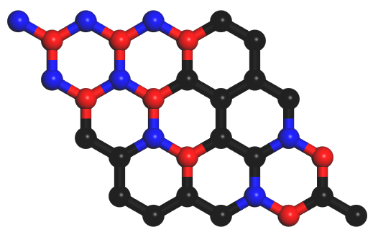
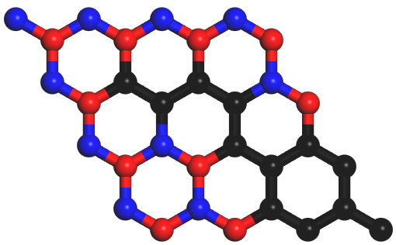
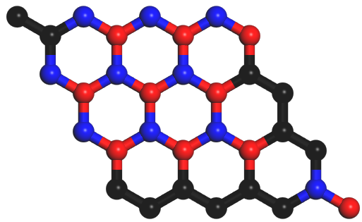
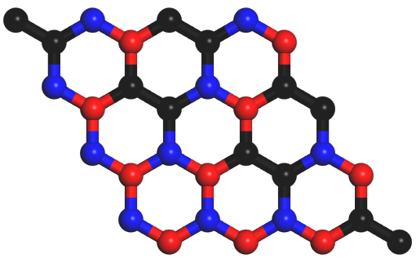
a
b
c
0.9525 eV
1.2867 eV
1.5705 eV
50 % Dopant
1.1725 eV
1.7789 eV
2.2550 eV
62.5 % Dopant
Figure 1. (a, b) Band structures of pristine graphene (a) and pristine h-BN (b). (c) Representative atomic configurations of 4 × 4 graphene supercell systems that have the same B-N dopant concentrations (50% and 62.5%) but with different topological states and their corresponding bandgaps. C, N, B atoms are colored with black, blue and red.

Slide 3
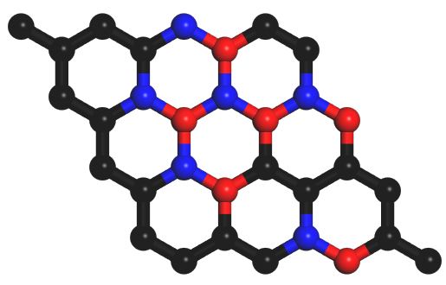
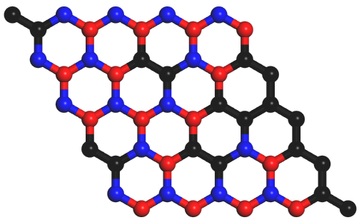
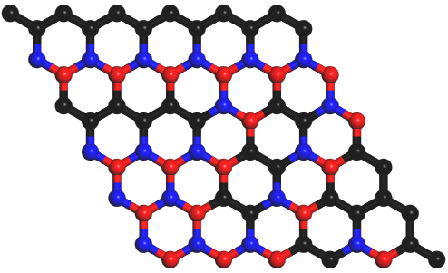
“1”
a
“0”
1.1654 eV
4×4 system
1.7094 eV
5×5 system
1.5020 eV
6×6 system
b
Input Volume
1st Conv-Layer
2nd Conv-Layer
2D Structure
Combine into 2-D data
1st FC-Layer
2nd FC-Layer
3rd FC-Layer
16th Conv-Layer
Global MaxPooling Layer
BandGap=
0.8895942
1.2304895
1.2039482
2.3049857
……
Out Layer
Figure 2. (a) Descriptors of 2D doped graphene systems. (b) A convolutional neural network for the 2D doped graphene systems.

Slide 4
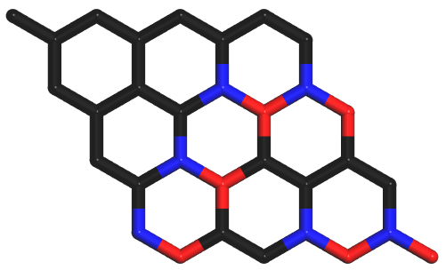
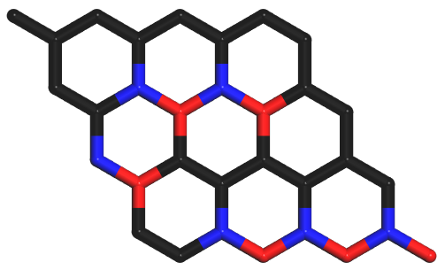
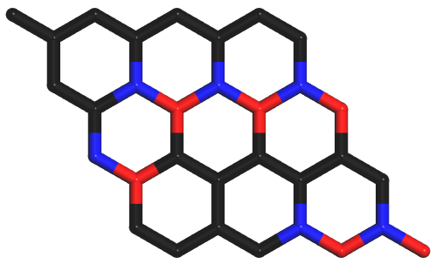
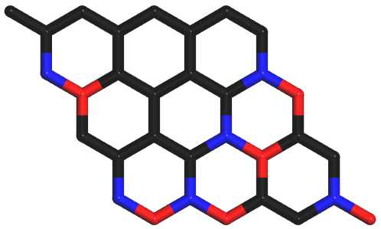
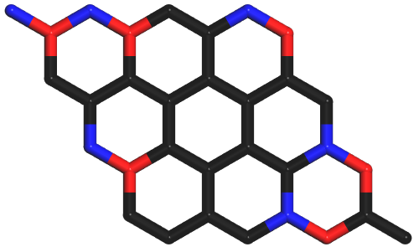
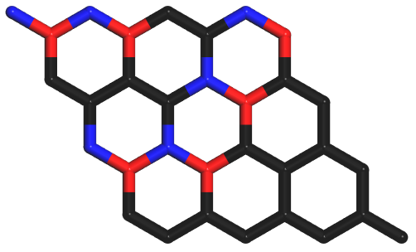
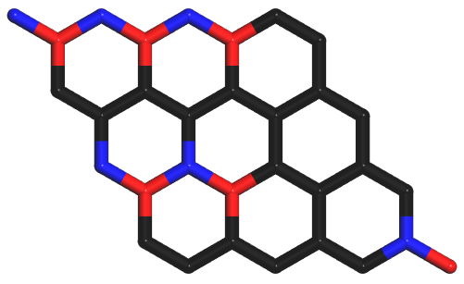
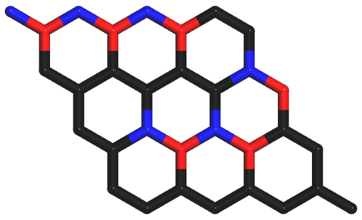
Figure S1. Examples of equivalent structures obtained by translating the particular structures along their lattice axis or inversion around their symmetry axis for 4 × 4 system.

Slide 5
a
BandGap=
0.8895942
1.2304895
1.2039482
2.3049857
……
Output value
Input data
Conv-Layer
Res_Block
Res_Block
Res_Block
Global MaxPooling Layer
FC-Layer
FC-Layer
Figure.S2 The structure of residual convolutional network (RCN).

Slide 6
Conv-Layer
Res_Block
b
1st Convolution Block
1st Identity Block
2nd Identity Block
Add_Layer
Add_Layer
Add_Layer
Input layer
Conv-Layer
Conv-Layer
Conv-Layer
Out_Layer
Conv-Layer
Conv-Layer
Conv-Layer
Out_Layer
Conv-Layer
Conv-Layer
Conv-Layer
Out_Layer
Figure.S2 The structure of residual convolutional network (RCN).

Slide 7
a
BandGap=
0.8895942
1.2304895
1.2039482
2.3049857
……
Output value
Input data
Conv-Layer
Conv-Layer
Concatenate Layer
CB
CB
Global MaxPooling Layer
b
FC-Layer
FC-Layer
1st CB
2nd CB
N^{th} CB
Input layer
Conv-Layer
Bottleneck Layer
Conv-Layer
Concatenate Layer
Conv-Layer
Bottleneck Layer
Conv-Layer
Concatenate Layer
Figure.S3 The structure of concatenate convolutional network (CCN). (a) The whole architecture of the CCN. (b) The detail about the connection between two concatenate blocks (CBs).

